Slide 1

Lightweight Transradial Prosthetic Able to Withstand Mechanical Forces during a Human Fall
Sarah McBryan

Slide 2
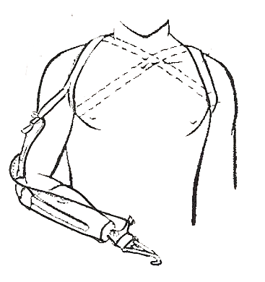

Types of transradial prosthesis
Body-powered
Externally/battery powered
Uses cables and body movement to simulate movement in the prosthesis
Limited, but reliable movement
Uses lithium gel batteries to power motors or other such actuators to simulate movement
Movement dependent on bio signals
DOF
http://www.upperlimbprosthetics.info/index.php?p=1_9_Body-Powered
http://www.upperlimbprosthetics.info/index.php?p=1_10_Externally-Powered

Slide 3
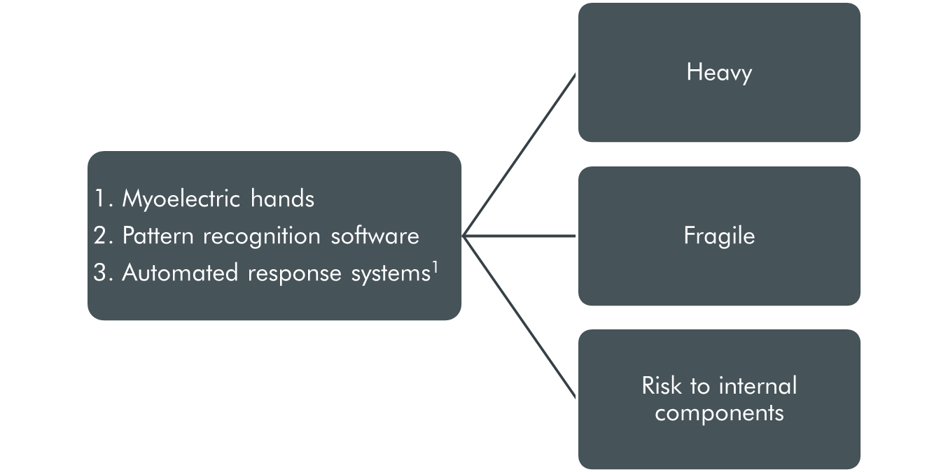
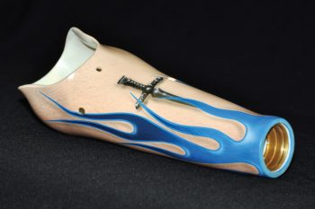
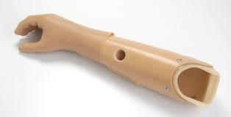
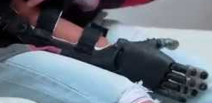
New advancements
http://www.oandp.com/articles/images/2011-12_02/12-02_02.jpg
http://www.synergypo.com/?page_id=255
https://img.youtube.com/vi/Lm9d-M6TERQ/0.jpg

Slide 4
New advancements
http://www.synergypo.com/?page_id=255
https://img.youtube.com/vi/Lm9d-M6TERQ/0.jpg

Slide 5
New advancements
https://img.youtube.com/vi/Lm9d-M6TERQ/0.jpg

Slide 6
New advancements

Slide 7
Project Fishbone
We propose a lightweight transradial prosthetic shaft, created with advance manufacturing and press-fit techniques, to meet end-market and customer needs for patients with below the elbow amputations or congenital anomalies.
41,000 patients with upper-limb deficiencies [1]
Current market product failures [3-9]
  Weight
  Balance
  Durability
  Provides protective shielding to internal components

Slide 8
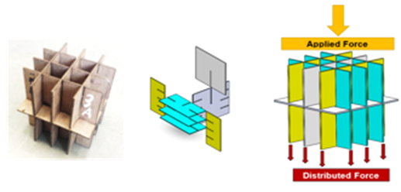
Press-fit application
Press-fit
  A design that uses interlocking pieces that are held together by friction as opposed to any other form of adhesive
  No glue, no composites
Cubic designs
  Simplified force diagrams
  Easy to build → Easy to test
  2, 3, and 5 fin models
Physical prototypes for cubic designs.
Exploded view of half the 3 fin cube. The fins are highlighted in teal and span horizontally across the design. Design was built by Coleen Fox and Hayden McIver in SolidWorks.
Depiction of an applied compressive force being distributed in six different ways through current design mechanisms.

Slide 9
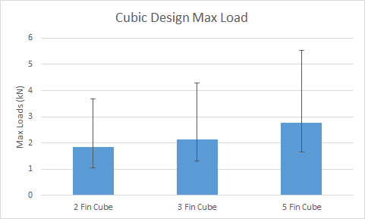
Cubic
Peak strength between designs was approximately 2.8 kN or 620 lbf
  5 fin design
Too strong?
  Device should fail further patient injury
Error bars are standard deviations between trials at max load
No significance was found between designs

Slide 10
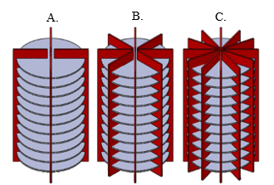
Cylindrical Designs
Designs had to be altered to closer fit final design concept
  Simple radial structure
    Effect on compressive strength
  Different height to base ratio
    Shearing
    Torsional strength
4, 8, and 12 fin cylindrical models were modeled and laser cut, these are shown as A, B, and C respectively
Initial cylindrical designs. The fins are highlighted in red. The circle bases are gray.

Slide 11
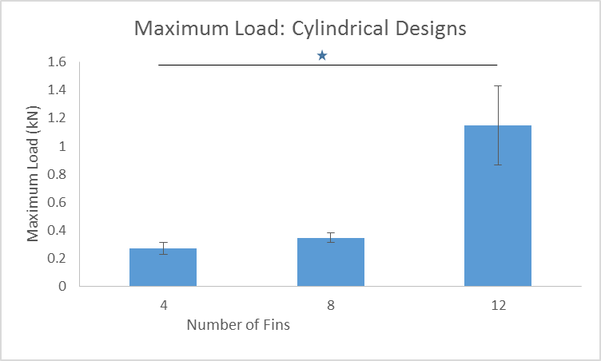
results
Peak strength was approximately 1.3kN or 300lbf
12 fin model
Mechanical strength requirements during a human fall is 500lbf [13]
Material considerations
  It can be hypothesized that an increase in material density will significantly increase overall device strength
Error bars are standard deviations between trials at max load

Slide 12
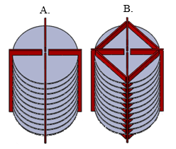
Torsional support
An adaptation of the 4 fin design was created to include support beams in order to increase resistance to torsional forces.
4 additional fins
45º angle
4T
Comparable to the 12fin model in compressive strength
Side-by-side comparison between the 4 fin and 4T design.

Slide 13
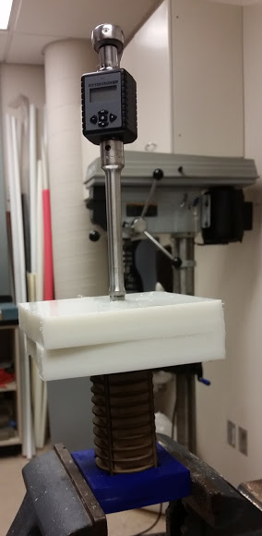
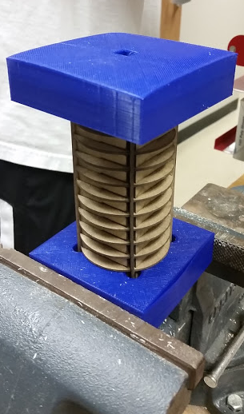
Torsional test
Vertical torque sensor was used to find peak values (Nm) for each design
Endcaps were created for each design
  Apply torque to 95% of fin area
  Fix, or rigid bottom
Torsional strengths met initial specifications for that of a human arm without injury to patient
  Approximately 16Nm

Slide 14
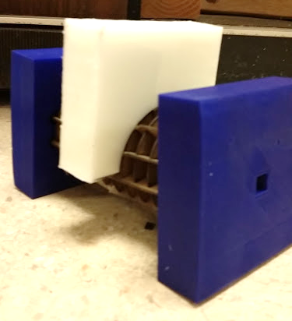
3-Point bending test
Center compression apparatus
  Distribute force to two center fins
Endcaps
    Not rigidly held
Instron applied force at a constant 20mm/min

Slide 15
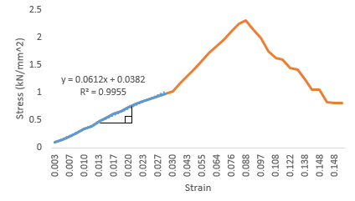


3-Point bending test: results
Using load and displacement, equations 1 and 2 were used to calculate stress and strain moduli respectively
(1)
  (2)
No statistical significance (p<<0.05)
  Young’s moduli
  Flexural yield strengths
  Maximum displacement

Slide 16
Interstitial free space volume
Weight
Distribution of internal components
  Tailor-made to patient point of care
Safely store and protect internal components

Slide 17
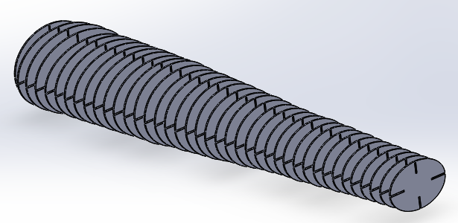
Fishbone
Offers new mechanical frame
  High compressive strengths
  Comparable torsional strengths
  High interstitial free space volume
Easily scaled or tailored to patient
  Balance

Slide 18
Acknowledgments
Thank you to Dr. LaBelle and Dr. Kingsbury for their mentorship, advice, and laboratory equipment. Special thanks to Hayden McIver and the Fishbone prosthesis laboratory group for inputs and help throughout the year.

Slide 19
references
[1] K. Ziegler-Graham, E.J. MacKenzie, P.L. Ephraim, T.G. Travison, R. Brookmeyer Estimating the prevalence of limb loss in the United States: 2005 to 2050 Arch Phys Med Rehabil, 89 (3) (2008), pp. 422–429
[2] Biddiss, Elaine A., and Tom T. Chau. "Upper Limb Prosthesis use and Abandonment: A Survey of the Last 25 Years." Prosthetics and Orthotics International 31.3 (2007): 236-57. Web.
[3] Schultz, Aimee E., Susan P. Baade, and Todd A. Kuiken. "Expert Opinions on Success Factors for Upper-Limb Prostheses." Journal of rehabilitation research and development 44.4 (2007): 483. Web.
[4] Davidson, Judith. "A Survey of the Satisfaction of Upper Limb Amputees with their Prostheses, their Lifestyles, and their Abilities." Journal of hand therapy: official journal of the American Society of Hand Therapists 15.1 (2002): 62-70. Web.
[5] O’Connell, Colleen. “Upper Limb Prosthetic Services Post Haiti Earthquake: Experiences and Recommendations of Haiti-Based Rehabilitation Program.” Journal of Prosthetics and Orthotics 2012 Vol. 24, Num. 2. pp. 77-79. Web.
[6] Wijk, Ulrika, et al. "Forearm Amputees' Views of Prosthesis use and Sensory Feedback." Journal of hand therapy: official journal of the American Society of Hand Therapists 28.3 (2015): 269-78. Web.
[7] O'Neill, Ciaran. "An Advanced, Low Cost Prosthetic Arm”. Web.

Slide 20
references
[8] Herbert, Nicholas, et al. "A Preliminary Investigation into the Development of 3-D Printing of Prosthetic Sockets." Journal of rehabilitation research and development 42.2 (2005): 141. Web.
[9] Gretsch, K. F., et al. "Development of Novel 3D-Printed Robotic Prosthetic for Transradial Amputees." Prosthetics and Orthotics International (2015) Web.
[10] O'Keeffe, Bernard. "Prosthetic Rehabilitation of the Upper Limb Amputee." Indian journal of plastic surgery: official publication of the Association of Plastic Surgeons of India 44.2 (2011): 246-52. Web.
[11] “Chapter 4 Mechanical Properties of Biomaterials". Biomaterials - The intersection of Biology and Material Science. New Jersey, United States: Pearson Prentice Hall Bioengineering. 2008. p. 152.
[12] Carey, Stephanie L., et al. "Golf Hand Prosthesis Performance of Transradial Amputees." Prosthetics and orthotics international 39.3 (2015): 244. Web.
[13] Chiu, James, and Stephen N. Robinovitch. "Prediction of Upper Extremity Impact Forces during Falls on the Outstretched Hand." Journal of Biomechanics 31.12 (1998): 1169-76. Web.
[14] O'Sullivan, LW, and TJ Gallwey. "Forearm Torque Strengths and Discomfort Profiles in Pronation and Supination." Ergonomics 48.6 (2005): 703-21. Web.
[15] "Flexure Test." Instron. N.p., n.d. Web. 24 Mar. 2016.

